Slide 1
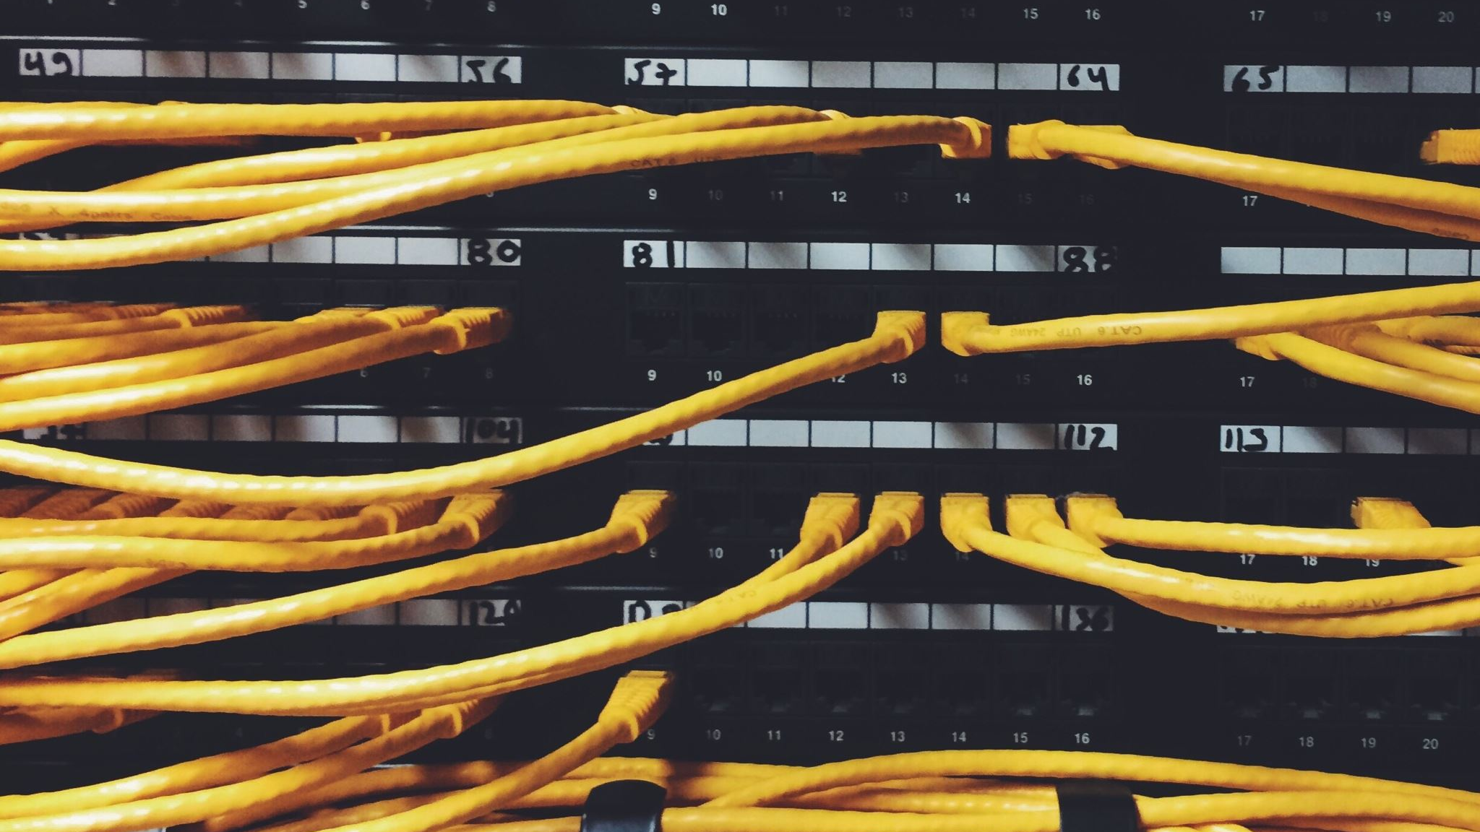
AlphaNet IPS Network
Presented By:
AMAL R RA2211032010015
LALITH SURYA G RA2211032010009
SHABARINATHAN KRV RA2211032010011

Slide 2
Purpose of the network
The main purpose is to develop and enhance the network infrastructure of AlfaISP from residential and business customers. This should include the spread of the network, maximizing network performance, detailed security measures, diversification of services, and efficient management of network resources with the least possible operational cost. With the success of these objectives, AlfaISP will be in a better position to sustain its robust positions within the region with superior customer service as well as market growth.

Slide 3
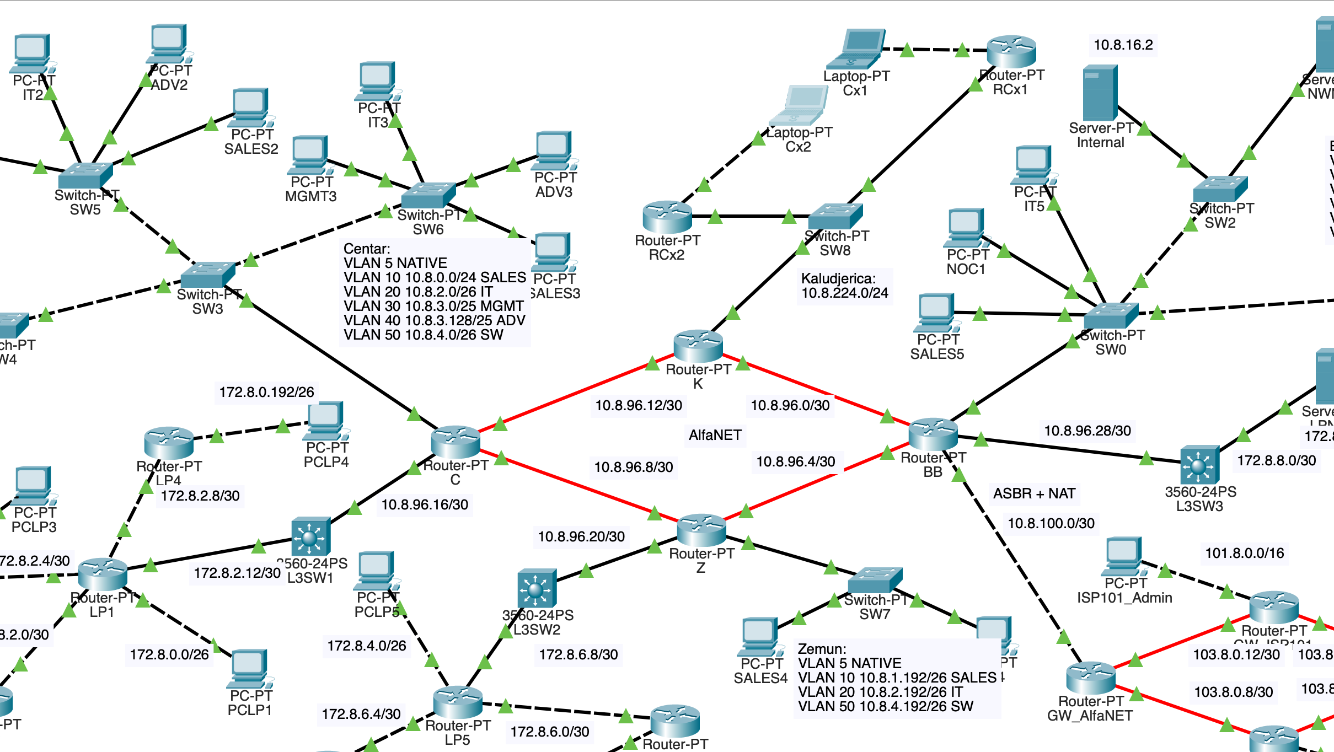
Network infrastructure

Slide 4
Network topology
BUS TOPOLOGY: In the given network, there are multiple interconnected switches, creating a more complex structure than a simple bus.
STAR TOPOLOGY: In this network, there are multiple layers of switches, and not all devices are directly connected to a central point.
HYBRID TOPOLOGY: By combining elements of both bus and star topologies, the network achieves a balance between simplicity, scalability, and redundancy.

Slide 5
CHALLENGES FACED
Network Complexity: Large-Scale Network: The network is quite extensive, involving multiple routers, switches, and devices. This complexity can make configuration, troubleshooting, and maintenance challenging. Multiple Protocols: The network utilizes various protocols like OSPF, BGP, RIP, VLANs, and NAT, which can increase the complexity of network management.
Security Risks: Vulnerability to Attacks: The network exposes multiple services to the internet, making it vulnerable to various cyber threats. Unauthorized Access: Implementing robust security measures is crucial to prevent unauthorized access.

Slide 6
CONCLUSION
This design is an integrated form of the network that considers all the needs of the whole organization; it takes into account the various factors such as scalability, security, and performance. The proposed network architecture would ensure reliability and efficiency considering the factors such as scalability, security, and performance.Advanced technologies such as BGP, OSPF, VLANs and NAT would bring about a very optimized performance and resilience in the network. Security measures include the implementation of ACLs, firewalls, secured sensitive information, and avoidance of unauthorized access. Modular design of the network shall allow easy accommodation of growth and customization. The need for growing or a change in business requirements can be undertaken with this modular network design. This modular design of the network has provided a good foundation to support successive success.

